Slide 1
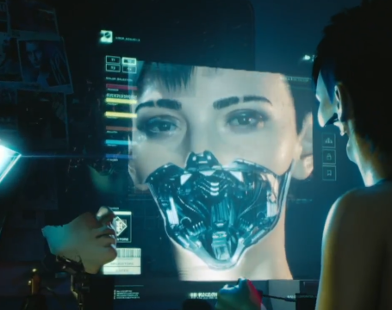
Customize Your Body
Shangyu Xie
&
Alwyn Tcha

Slide 2
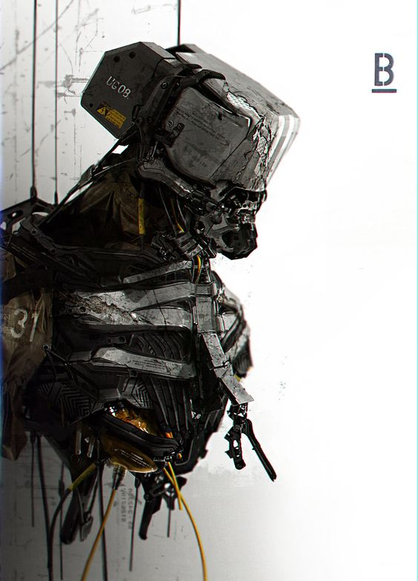
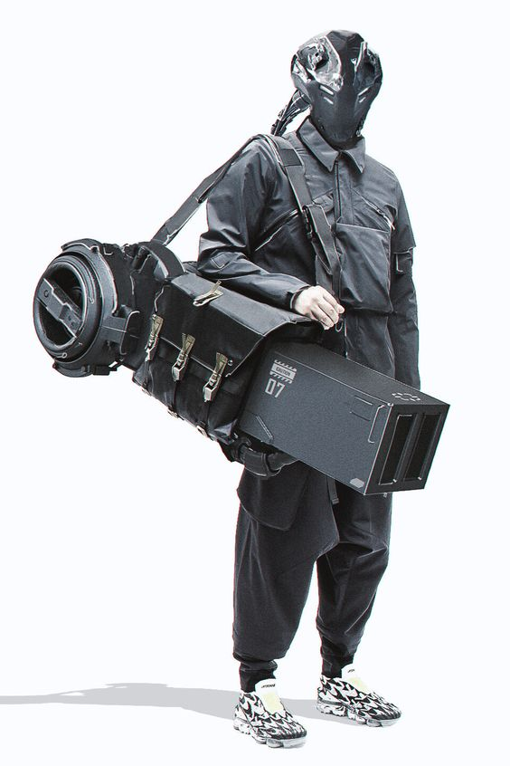
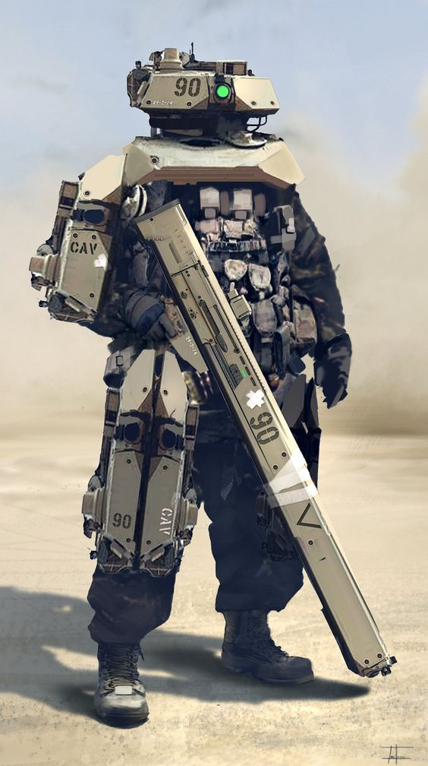
Concept: Cyberpunk

Slide 3
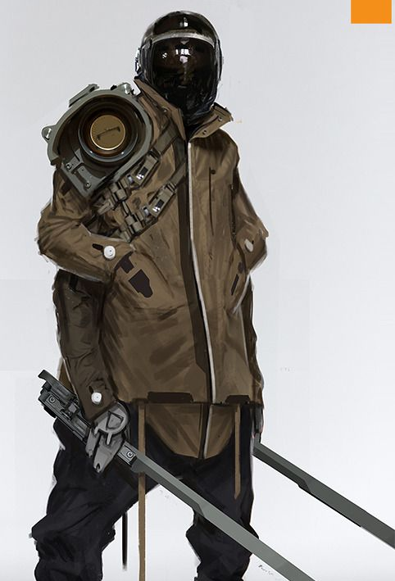
Basic idea
Users will initially get a virtual body, and users can modify their bodies according to their own preferences. We will use web cam. Take a picture of the user, and then make the user's avatar.
https://xieshangyu.github.io/week9/jump.html

Slide 4
JQUery Functions
Scroll-link
Scorll-top
Nav-toggle
Animate
->Scroll Function -> Moving to next page smoothly

Slide 5
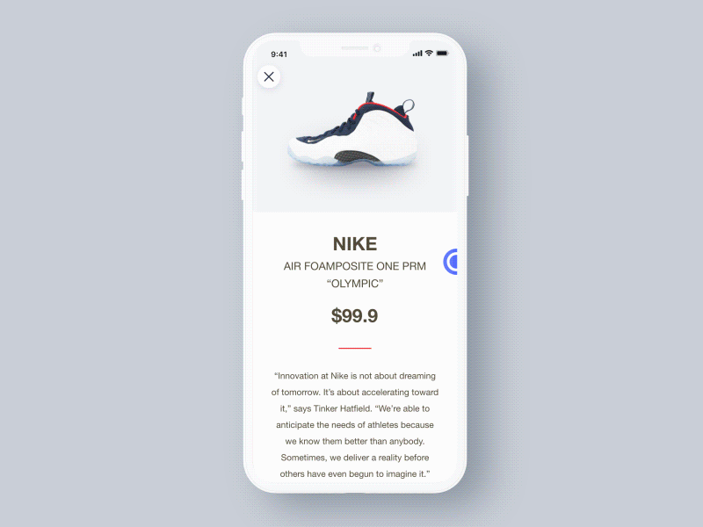
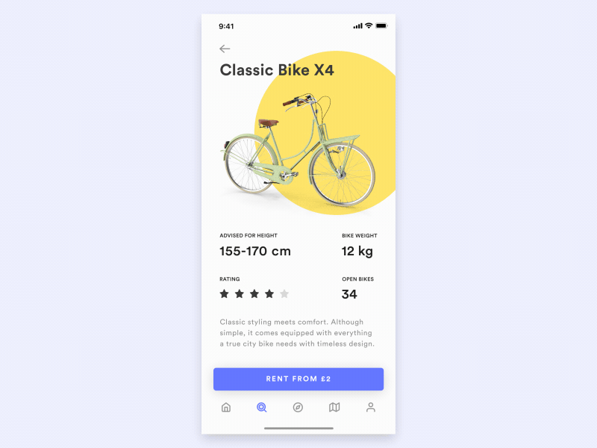
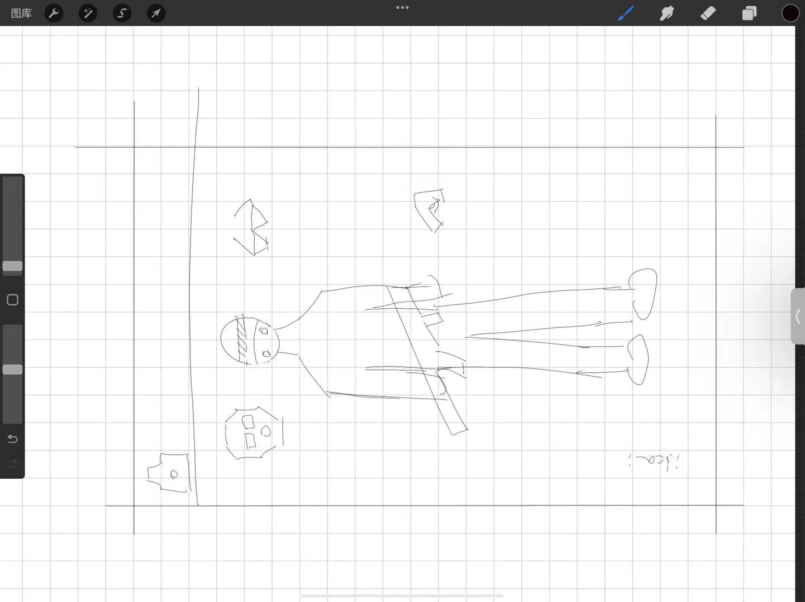
Basic site map & Wireframe
Everything on the same page
Because we want users to experience soft UX/UI

